Slide 1
IT Companies Analysis in India
By Team FCT Worriers

Slide 2
Introduction
Objective: Analyze Indian companies, especially in the IT sector
Focus Areas:
Private vs Public company distribution
Top companies by reviews
Growth of the IT sector
Top Most Recognized Companies

Slide 3
Tools & Techniques
We use Excel Tools:
Filtering & grouping
Chart Elements & Labels
Percentage Calculation
Trend line to show IT Sector Growth Over Years

Slide 4
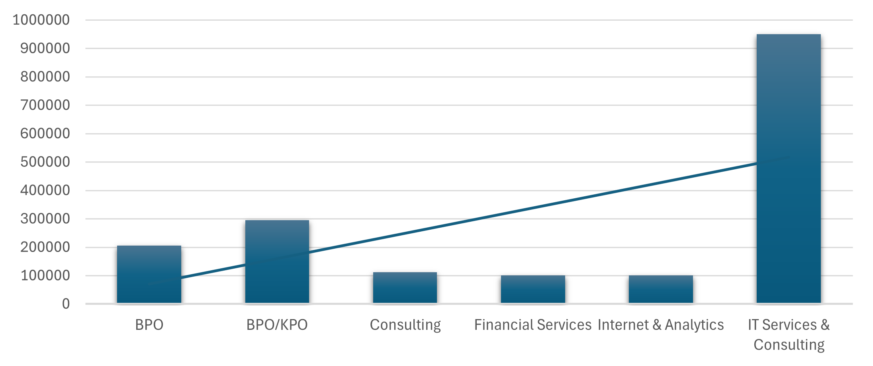
Most Demanding Companies
IT Services & Consulting is the most popular type of company
Highest number of employees 10 Lakh
Other companies have minimal employee around 2-3 Lakh

Slide 5
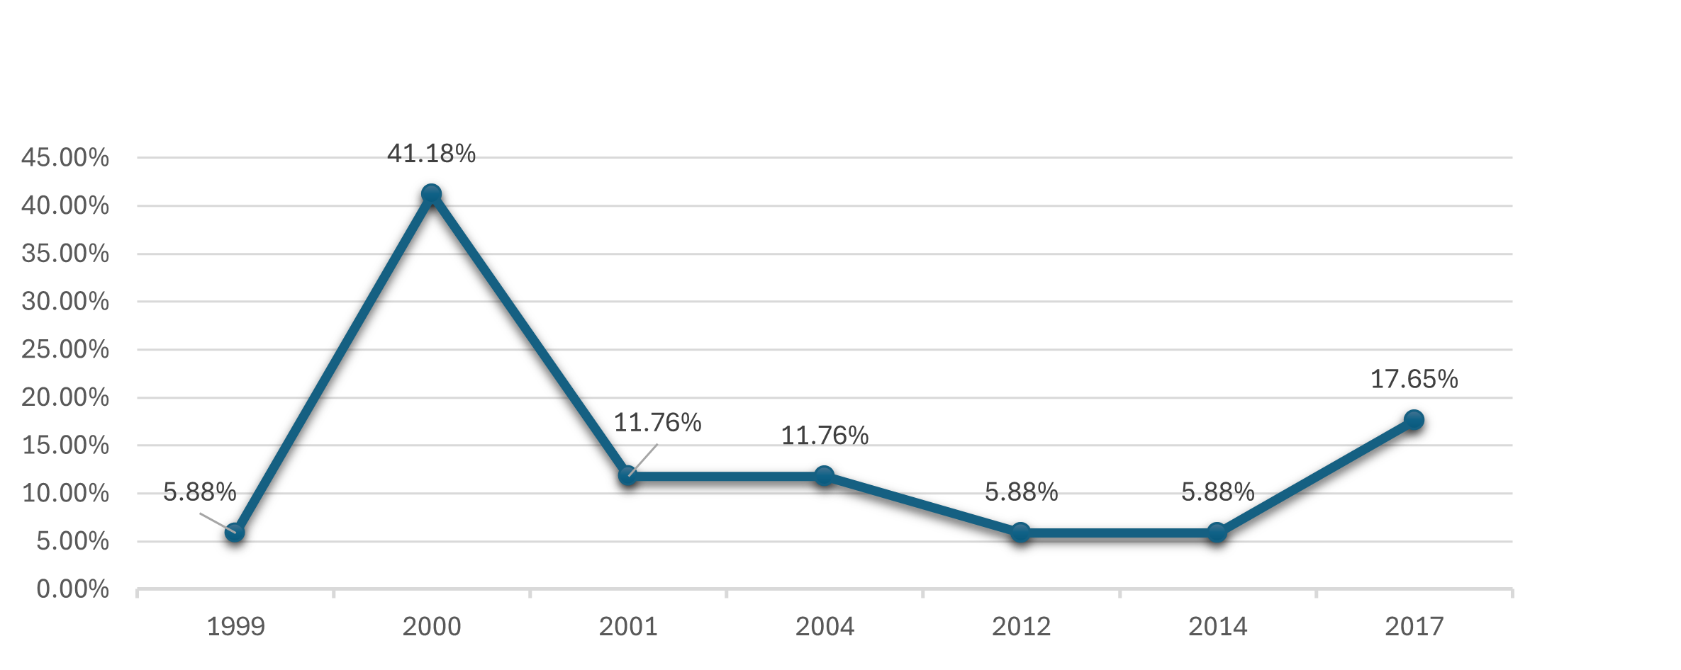
Growth of IT Sector 1990-2017
In 2000, IT growth was the highest 41%
After 2000, growth was lower, around 11%
In 2017, growth increased again to 17%

Slide 6
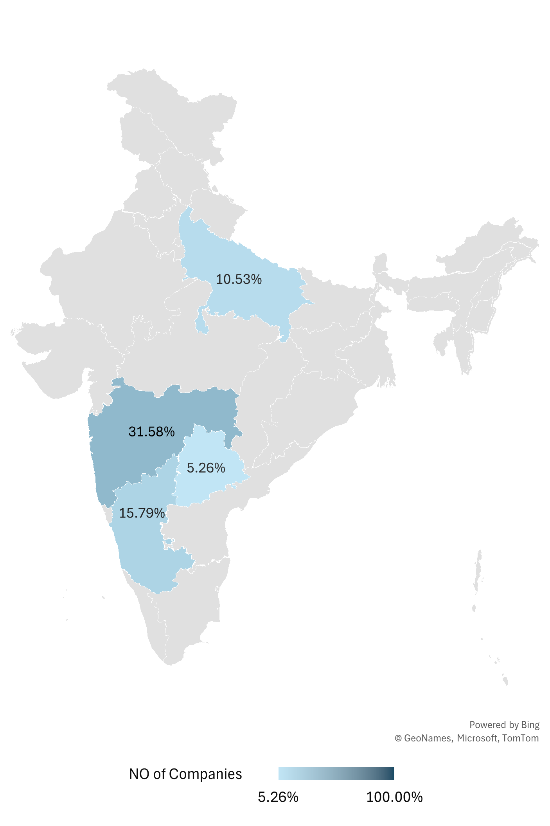
IT Companies in Indian States
Maharashtra has the most IT companies (31.58%)
Maharashtra is next (15.79%)
Uttar Pradesh has 10.53%, other states have less

Slide 7
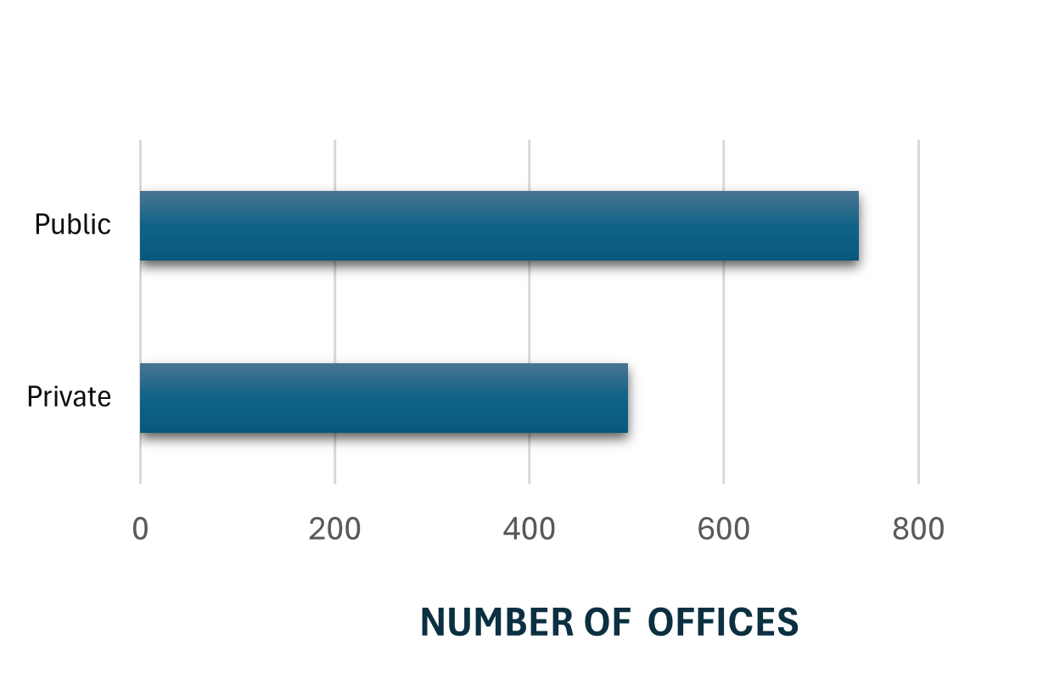
Comparison of Companies
Public vs Private Companies:
- Public: 739 offices
- Private: 501 offices

Slide 8
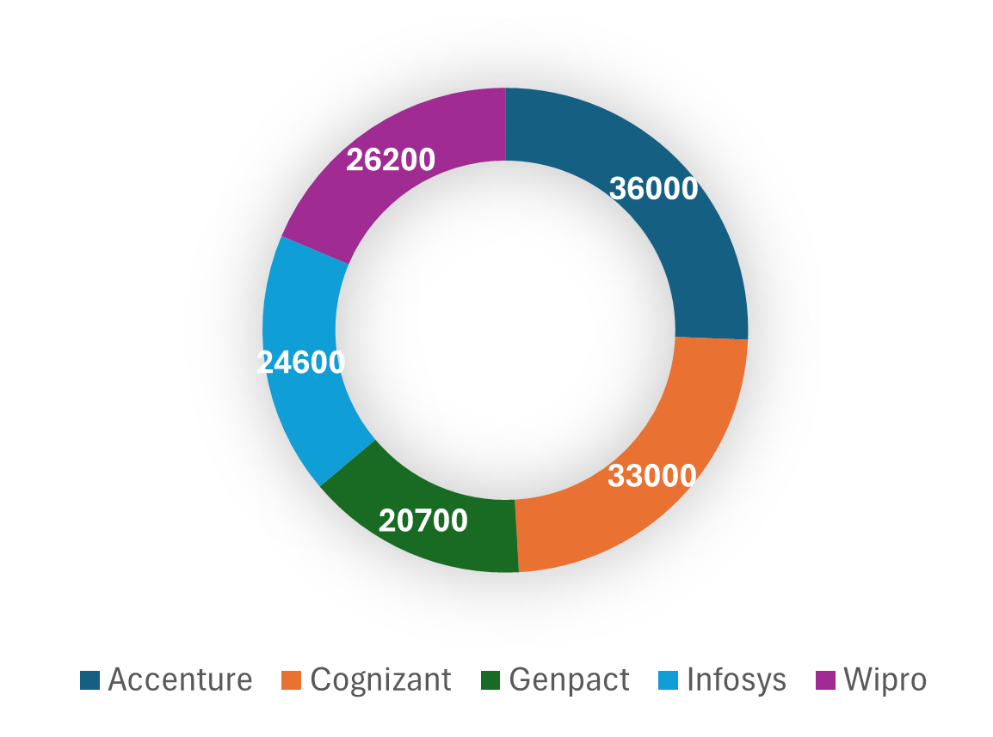
Top Companies in IT Services
Accenture has 36,000 employees.
Cognizant has 33,000. Wipro and Infosys follow

Slide 9
Conclusion & Future Scope
Conclusions:
- Public companies have more offices
- Accenture and Cognizant are top-reviewed
- IT industry shows steady growth
Future Improvements:
Include salary and financial data
Use Power BI for live dashboards
Gather real employee feedback

Slide 10
THANK YOU

